Slide 1
Presentation To the OMG BMI WG On Proposed Business Architecture Meta Model as a Candidate Standard
Presented By the Business Architecture Guild
June 21, 2016
Prepared & Presented on behalf of the Business Architecture Guild by:
Lloyd Dugan, BPM, Inc.
Jeffrey Wallk, The Value Enablement Group, Inc.
Jim Rhyne, Thematix, Inc.
William Ulrich, TSG Consulting, Inc.

Slide 2
Outline
BA MM Relevancy & Timeliness
BA MM Overview
BA MM Alignment With VDML MM
Concluding Remarks

Slide 3
BA MM relevancy & TIMELINESS
Why a BA MM?
Capability as the Centerpiece
Positioning BA MM
Unification of Concerns
Adoption of BA MM
Scenario-Driven BA MM

Slide 4
Why a BA MM ?
Business Architecture (BA) as a management discipline with its own practitioner community has matured to the point where a BA standard (from the OMG) will have meaningful and enduring value
A BA Meta Model (BA MM) for such a BA standard provides organizations with a simple and easy to understand way to define and align strategy with execution, using Capability as the centerpiece.
Capability is the natural starting point for a BA because it describes “what” a business does in a way that supports analysis of various related business management concerns by:
Engaging business and operational stakeholders about their relevant concerns (current state), and
Guiding them towards a progressive set of steps to achieve their goals and objectives (strategy) for the short term and over the long term (future states)

Slide 5
Capability as the Centerpiece
Conversation with and about the business starts with the core concept – Capability
Capability is the “1st Class Citizen” of the framework used to describe Business Architecture, enforcing alignment with it
Provides business management the bridge between strategy & execution in support of evaluations and analyses
Scenarios range from mergers & acquisitions to strategic planning to various types of portfolio management
Impact by and impact on Capability is understood and analyzed by the examination of business management concerns related to Capability
For example, Value provides the bridge between what Stakeholders want and what is delivered by the Organization

Slide 6
Positioning BA MM
BA MM is the ONLY MM that positions Capability as its Core, which supports a more natural flow of understanding and unbiased treatment of related concerns and concepts vertically and horizontally (within organizations and across organizations)
Once a BA MM is in place for an organization to use, all other (relevant) meta models can be incorporated and positioned in a straightforward manner to address increasing complexity and domain-specific concerns – an example of this is the inclusion of Capability in other existing MMs (including VDML, DoDAF, and TOGAF)

Slide 7
Unification of Concerns
A BA MM provides a common starting point with organizations by leveraging Capability, from which we can accommodate increasing levels of complexity and extensibility by aligning the concepts in the BA MM with existing meta models (including but not limited to UPDM/UAF, VDML, BPMN, CMMN, DMN, SBVR)
Capability supports both the vertical alignment (strategy & execution) as well as the horizontal and orthogonal extensions for addressing other architecture concerns (within the supply chain and across value chains), unifying these examinations

Slide 8


Adoption
Variations for candidate BA MM have been adopted, are under review for adoption, or have been or are being user implemented across numerous tool vendors (see list)
Candidate BA MM is based on the concepts captured across practitioner communities, as embodied in the BIZBOK®, which has wide adoption across government, institutions, commercial, and non-profit (US & International)

Slide 9
Scenario-Driven BA Meta Modeling
The BA MM was derived from the practitioners of Business Architecture and the organizations by leveraging common business scenarios:
Investment Analysis
Shift to Customer Centric Business Model
Merger & Acquisition Analysis
New Product/Service Rollout
Globalization
Business Capability Outsourcing
Supply Chain Streamlining
Divestiture
Regulatory Compliance
Change Management
Operational Cost Reduction
Joint Venture Deployment

Slide 10
BA MM Overview
Location of BA MM within Modeling Spectrum
BA as the Center-of-Gravity of Modeling Standards
Capability as 1st Class Citizen
Layered Approach for BA MM
BA Meta Modeling Approach – Some New Thinking
Key BA Meta Modeling Concepts – Packages, Stereotypes, and Proxies
BA MM Core Packages
BA MM Concept Definitions

Slide 11



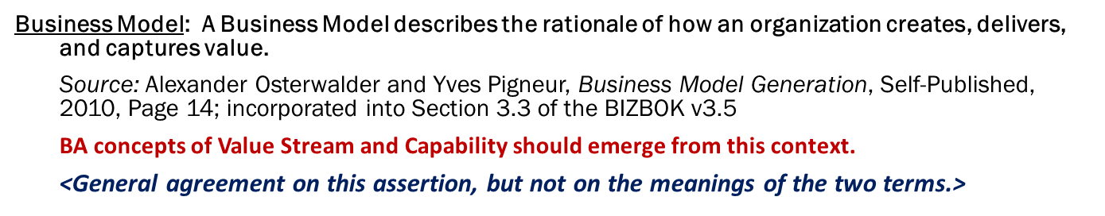
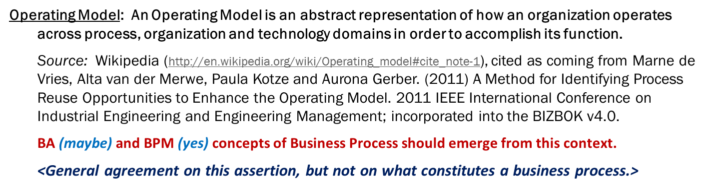
Location of Business Architecture on Modeling Spectrum
Senior Management
LOB Manager
Line Supervisor
Line Worker
Business Model
Perspective:
What It Is the
Business Is Doing
Operating Model
Perspective:
How the
Business Is Doing It
The
What-How
of the Business
Focus of BA
Source: Training Material Provided for Purpose of this Presentation Only
All Rights Reserved To Lloyd Dugan

Slide 12
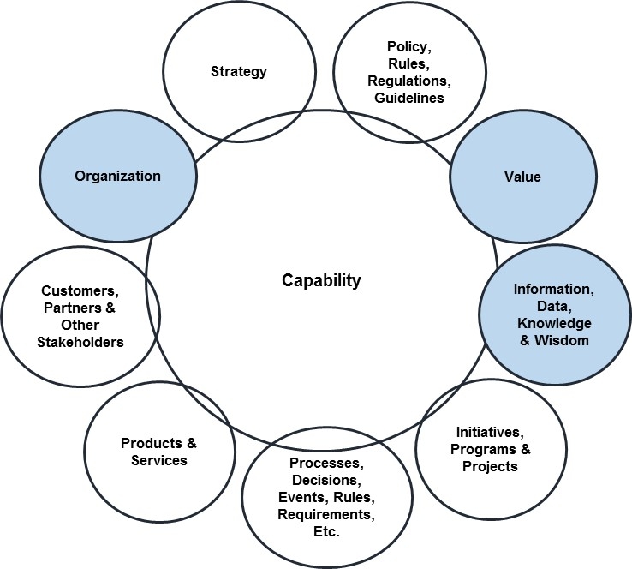
BA as the Center-of-Gravity of Modeling Standards
Scenario-based management concerns of business management need a top-level standard for modeling Business Architecture, which organizes around the concept of Capability as the “1st Class Citizen” of the BA MM
Semantics need to be loose enough to support mapping to other architecture descriptions and related OMG standards, but strong enough to support analysis of impact on and impact by Capability on those concerns
Begin with stripped-down, first-cut of the BA MM built around Capability (as a package) with some viewpoints and views (as other packages) that are of initial and critical importance for the BA MM as well as generally considered included (Value, Organization, and Information)
Some of the petals will become part of the BA MM with explicit mappings, while others will map to the BA MM through implicit mappings

Slide 13
Capability as “1st Class Citizen”
It means that – in a very meaningful way – a single concept in the MM is the reason for every other concept to be attached to it in some fashion
Equivalent “centricity” rule: removal of the core concept destabilizes the MM
Examples from OMG’s operational modeling standards:
In BPMN, “Activity” is first class citizen
Process model orders activity through Sequence Flow, Gateways, and Events – little in the MM does not map back to it
In CMMN, “Event” is first class citizen
Case model identifies Event-Condition-Act (ECA) moments that change the state of the Case and/or direct Tasks as work on the Case – little in the MM does not map back to it
In DMN, “Decision” is first class citizen
Decision model maps the Decision Logic and Data Inputs that support the Decision – little in the MM does not map back to it
A straightforward “rule of thumb” enables the use of the first class element to be used to control what goes into the Core
Semantic Distance Rule: no Core concept or package central concept should be more than 2 hops (relationships) away from Capability unless it is needed to resolve ambiguities or complex n-ary relationships that otherwise emerge from the BA MM

Slide 14
Layered Approach for BA MM Conceptual View
Extensions to other standards, and relevant architecture disciplines *
Extension
Companion concerns, standards, and related business architecture concepts *
Penumbra
CORE
* Formalized as MMs or perhaps not. These are
mapped to the BA MM via proxy relationships
INFORMATION
ORGANIZATION
CAPABILITY
Core Package where Capability is 1st class citizen
VALUE
Core Concepts viewpoints/views (initially drawn from the Penumbra) as packages **
** Subject to a semantic distance rule for proximity to Core Package

Slide 15
BA Meta Modeling Approach Some New Thinking
As a centralizing standard with respect to other, related architecture descriptions, the BA MM’s semantics should be engineered to be connectible to these other architecture descriptions through an explicit mechanism while preserving internal structure needed by a BA to support its various scenarios
Packages added to the Core will be introduced that are built around a central concept (making this somewhat more like an ontology modeling exercise than a pure MOF-based effort)
Stereotypes will be called out that support the conceptual distinctions needed to make a BA a practical construct that is comparable to other BAs and has impactful value to a specific business
Proxies will be used to resolve and disambiguate conceptual, relationship, and granularity differences between BA MM concepts and concepts in other, related architecture descriptions, standards, etc.
This is similar to the use of a “remote proxy” design pattern that provides a “local representative for an object in a different address space” (see pp. 207-217 in Design Patterns – Elements of Reusable Object-Oriented Software, by Erich Gamma, Richard Helm, Ralph Johnson, and John Vlissides, 1995)
A potential approach and basis for this approach is suggested in an academic treatment in 2001 (see http://www.math.u-szeged.hu/tagok/mmaroti/pdf/2001%20On%20metamodel%20composition.pdf)

Slide 16
Key BA Meta Modeling Concepts Packages, Stereotypes, & Proxies
Packages define Viewpoints and associated Views, with a central concept in each package that is within the semantic distance rule constraint with respect to Capability (generally not more than 2 hops), allowing further elaboration around that central concept in the package
Stereotypes are used: <<generic>> is applied to concepts that are used to describe things in a similar way across multiple and different business domains, while <<specific>> is applied to concepts that are used to describe business-specific realizations within a specific domain
Proxies are used – elements from outside the BA MM map through proxy elements (another stereotype) so as to position concepts that relate to things in the BA MM in a way that allows other architecture descriptions, related OMG standards, and other expressions lacking formal meta models to be mapped simply and straightforwardly

Slide 17
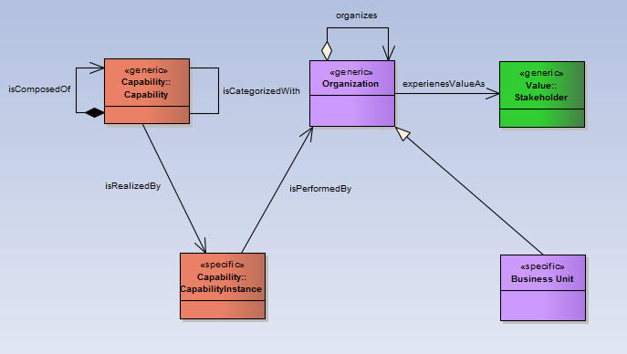
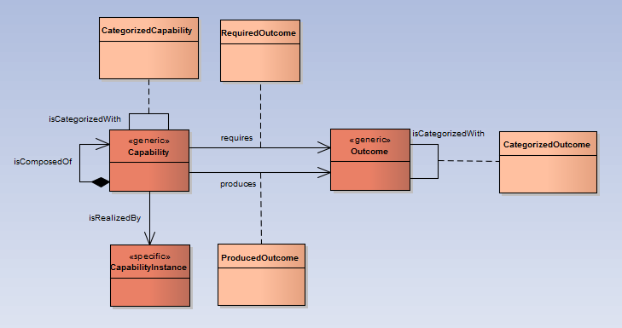
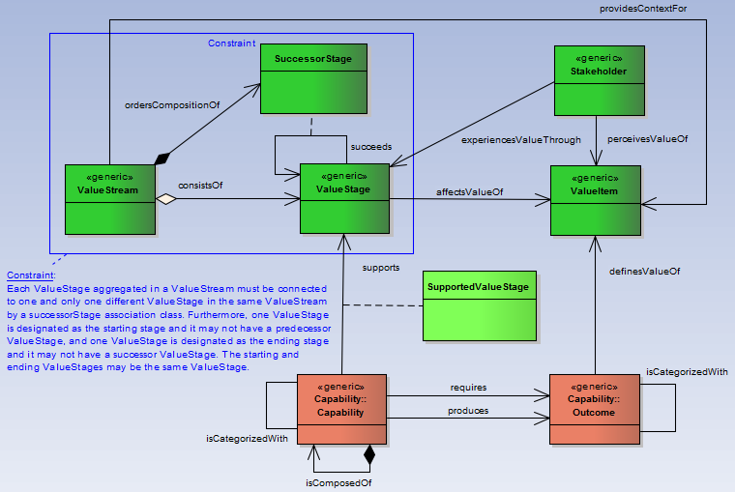
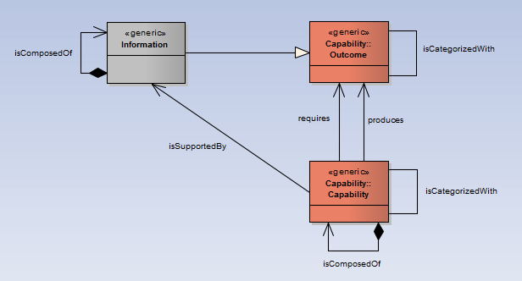
BA MM Core Packages
Organization Package
Capability Package
Information Package
Value Package

Slide 18
BA MM Concept Definitions
Concept | Definition
Capability | A particular ability or capacity that a business may possess or exchange to achieve a specific purpose or outcome.*
Capability Instance | A distinct implementation of a capability, as it is utilized within a specific business unit, value stream, or other deployment.
Categorized Capability | A logical grouping of capabilities that facilitates searching for related capabilities
Outcome | An end result or final product that is a consequence of an event, action, or a series of events / actions. For example, a strategy, an initiative, or a value stream would produce an outcome.
Produced Outcome | Outcome produced by a capability being realized
Required Outcome | Outcome required by a capability so it can be realized
Organization | A social unit of people, systematically structured and managed to meet a need or to pursue collective goals on a continuing basis
Business Unit | A logical element or segment of a company (such as accounting, production, marketing) representing a specific business function, and a definite place on the organizational chart, under the domain of a manager. Also called department, division, or functional area.
*Ulrich Homann, “A Business-Oriented Foundation for Service Orientation”, 2006.
Definition adopted by Open Group in “Business Capabilities Guide”, 2016
Definition adopted by Business Architecture Guild, BIZBOK® Guide, 2011

Slide 19
BA MM Concept Definitions
Concept | Definition
Information | Data that has been verified to be accurate and timely, is specific and organized for a purpose, is presented within a context that gives it meaning and relevance, and that can lead to an increase in understanding and decrease in uncertainty.
Value Stream | An end-to end collection of activities that create a result for a customer, who may be the ultimate customer or an internal end user of the value stream
Value Stage | A distinct, identifiable phase or step within a value stream that has a unique name, entrance criteria, exit criteria, and identifiable participating stakeholder(s).
Value Item | The judgment of worth, made by an individual or organization, attached to something tangible or intangible and attained in the course of a particular interaction with one or more other parties.
Successor Stage | Provides a directional flow for a value stream to guide the alignment of the value stages
Supported Value Stage | Value stage in one or more value streams that is supported by a capability

Slide 20
BA MM alignment with vdml mm
Positioning VDML MM with BA MM
Role of Capability in VDML
BA MM & VDML Alignment Approach
BA MM – VDML MM Alignment Summary
BA:Capability Alignment With VDML:Capability
BA:Capability Alignment With VDML:Value
BA MM & VDML MM as ISO Architecture Descriptions

Slide 21
Positioning VDML MM with BA MM
VDML provides an opportunity for Business Architects to publish the BA MM into VDML to measure value (from a transactional perspective), using traditional analytical methods
This scenario may be a bit further downstream for most Business Architects and the organizations they serve given current maturity levels around Business Architecture, but it will become increasingly important over time
Meanwhile, VDML’s treatment (via SMM mapping) of the measurability of Capability-related concepts (such as in a heat map) is well thought out and could be the basis for the BA’s own treatment

Slide 22
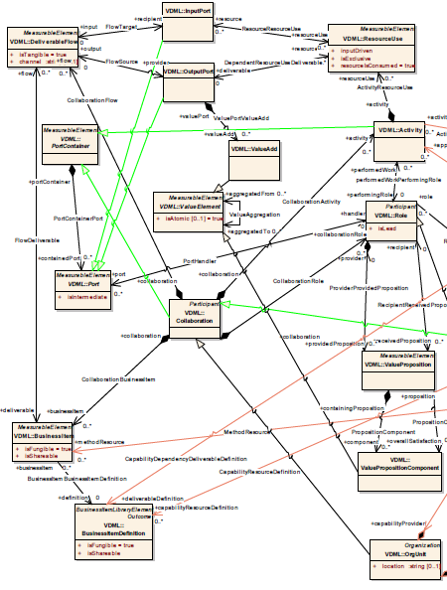
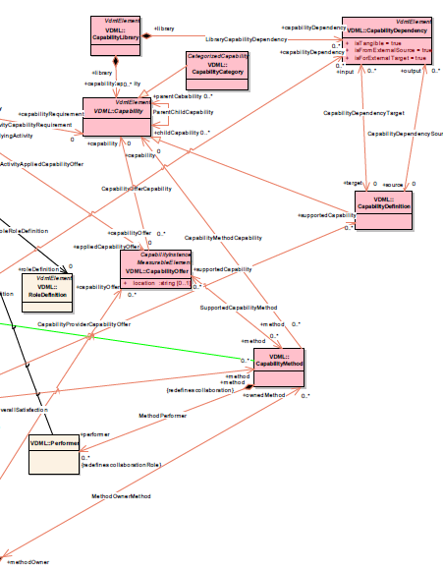
Role of Capability in VDML
VDML:Capability-related concepts provide finer-grained measurability associated with VDML:Activity, VDML:BusinessItem, and VDML:BusinessItemDefinition…

Slide 23
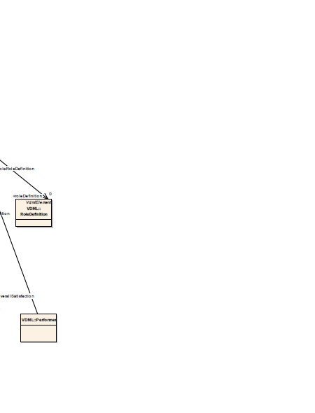
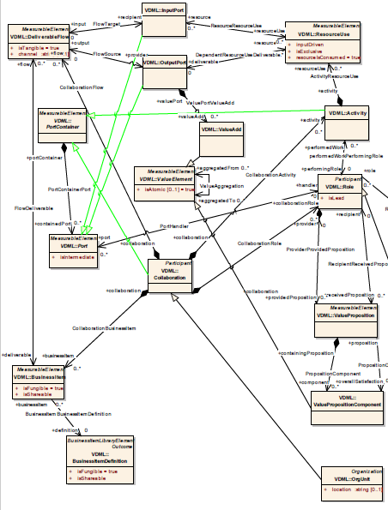
Role of Capability in VDML (cont’d.)
…But VDML:Capability-related concepts are tertiary concepts in VDML – complete removal (all relationships being optional) has no material impact on the rest of VDML other than to make the measurement of value creation more coarse-grained, thus – per the “centricity” rule – VDML cannot be said to be Capability-centric (though still very important as Value-centric)
Core elements in VDML related to value creation

Slide 24
BA MM & VDML MM Alignment Approach
A proxy-based approach has not been applied (given its proposed status), but should it be accepted going forward, it would likely yield something like this:
Otherwise, a more classic approach would be to find equivalences between analogous elements in the BA MM and VDML MM (similar to “isA” relationships in ontology modeling), which are represented as inheritance in subsequent slides
Whichever of a pair of analogous BA MM and VDML MM concepts are perceived to have the looser semantics becomes the super class
Not all concepts have equivalences, most notably because the BA MM’s Value Stream treatment of value creation is too dissimilar to VDML’s treatment of value creation
BA:BAElement
VDML:VDMLElement
From VDML MM
BA:ValueItem
Proxy:ValueProposition
VDML:ValueProposition
BusinessModelCanvass:ValueProposition
Derived from Business Model Canvass

Slide 25
BA MM – VDML MM Alignment Summary
BA MM Concept | Relationship | VDML MM Concept
Capability | Generalizes To… | CapabilityDefinition
Outcome | Specializes To… | BusinessItemDefinition
CapabilityInstance | Specializes To… | CapabilityOffer
ProducedOutcome | Generalizes To… | CapabilityDependency
RequiredOutcome | Generalizes To… | CapabilityDependency
CategorizedCapability | Specializes To… | CapabilityCategory
Organization | Specializes To… | OrgUnit
ValueItem | Generalizes To… | ValueProposition
Stakeholder | Generalizes To… | RoleDefinition
ValueStream | N/A due to incompatible granularities between Value-related concepts | Rough equivalences between constructs may be asserted based on the specific uses of BA:Capability-related mappings that can be mapped to VDML:Capability mappings
ValueStage
SuccessorStage
SupportedValueStage

Slide 26
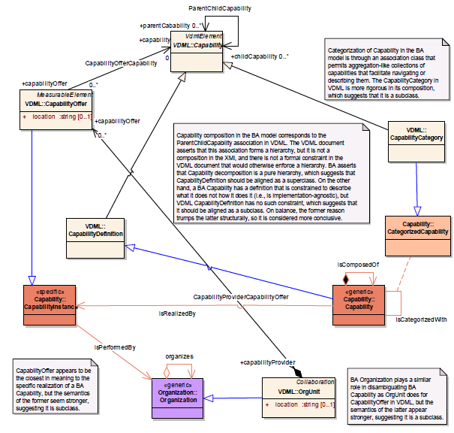
BA:Capability Alignment With VDML:Capability (1)

Slide 27
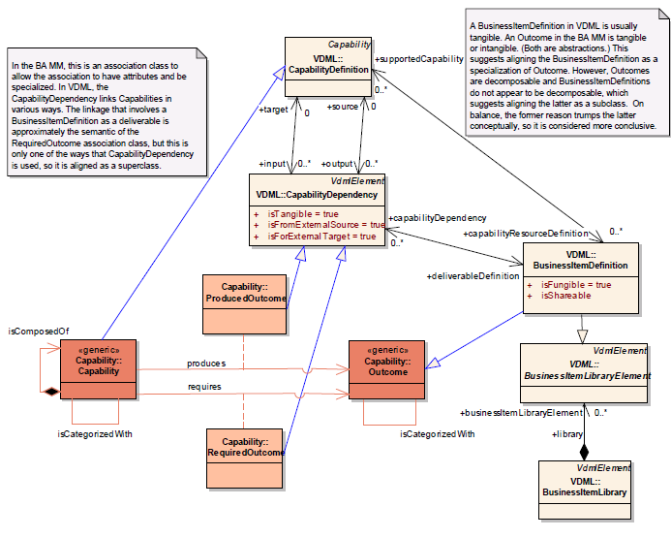
BA:Capability Alignment With VDML:Capability (2)

Slide 28
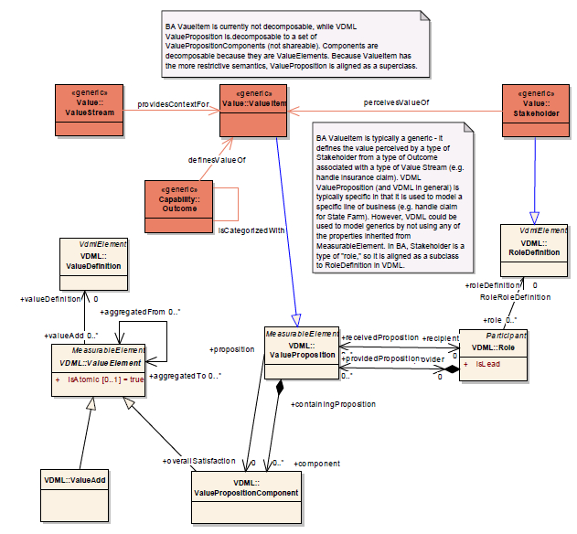
BA:Capability Alignment With VDML:Value (1)

Slide 29
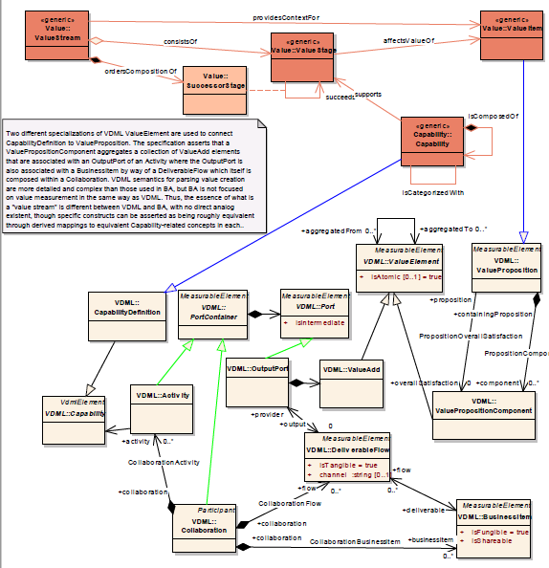
BA:Capability Alignment With VDML:Value (2)

Slide 30
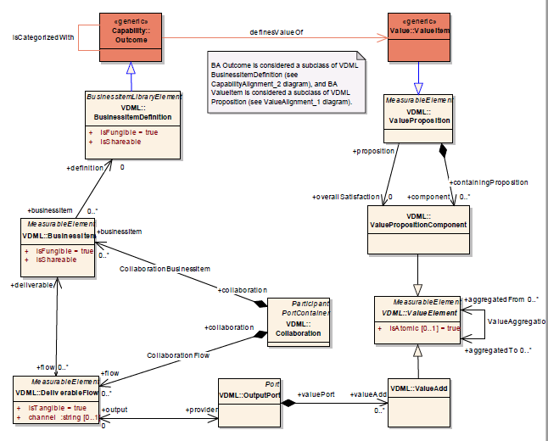
BA:Capability Alignment With VDML:Value (3)

Slide 31
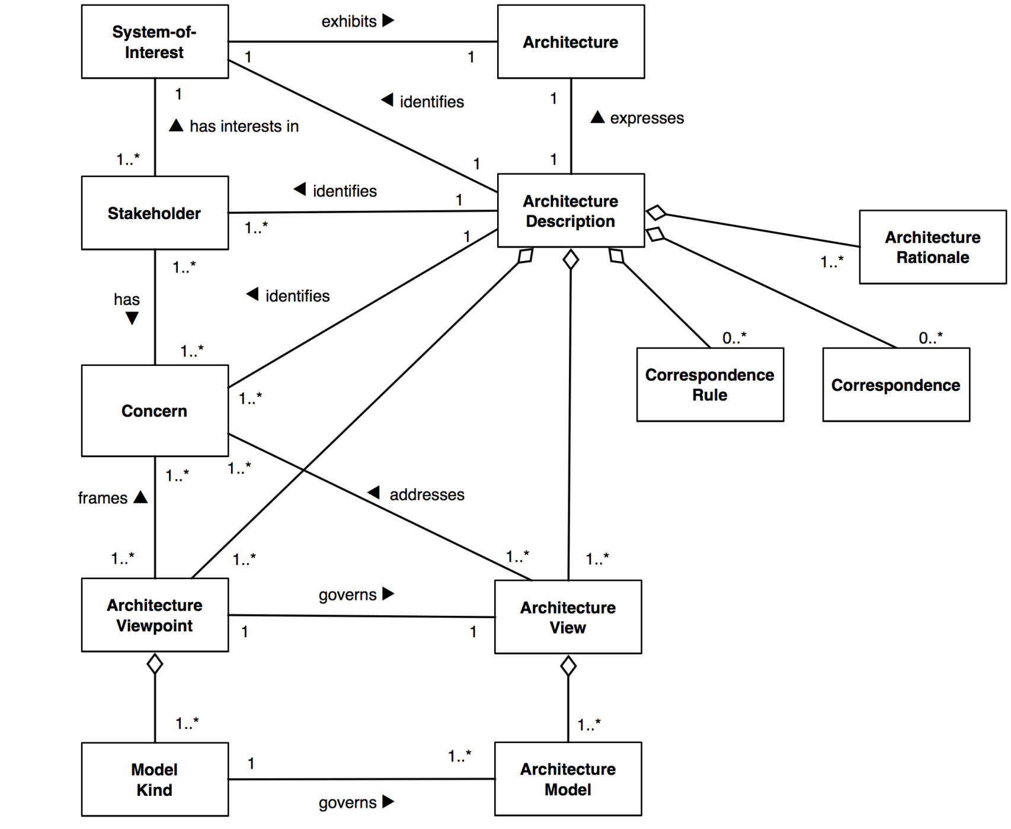
BA MM as an ISO Architecture Description
“The Business”
“Business Architecture”
“Business Management”
“Alignment of What the Business Does (Capabilities) With Management Concerns”
With BA as the Architecture Description, Capability’s impact on and impact by the Management Concerns of Business Managers can be Views governed by the packages of the Capability-centric BA MM…
“Relationships Between Capabilities and Management Concerns”
“Packages for Views that Are Anchored To Capability”
The latest version is always available at:
http://www.iso-architecture.org/42010/templates/.
The template is licensed under a Creative Commons Attribution 3.0 Unported
License. For terms of use, see:
http://creativecommons.org/licenses/by/3.0/

Slide 32
VDML as an ISO Architecture Description
“Value Creation”
“VDML”
“Business Management”
“Analysis and Measurement of Value Creation”
…With VDML as the Architecture Description, Capability’s role in value creation can be a View governed by the Capability-related portion of the VDML MM, but this is much narrower than a Business Architecture’s View of Capability’s role across a number of business model concerns governed by a Capability-centric BA MM
“Relationships Between Value Creation Elements”
“Measurable Aspects of Value Creation By Area of Focus”
The latest version is always available at:
http://www.iso-architecture.org/42010/templates/.
The template is licensed under a Creative Commons Attribution 3.0 Unported
License. For terms of use, see:
http://creativecommons.org/licenses/by/3.0/

Slide 33
Concluding Remarks
Suggested Next Steps
Questions & Answers

Slide 34
Suggested Next Steps
Obtain feedback on BA MM and alignment with other standards (esp. VDML)
Align on the Core Packages for BA MM
Align on the modeling approach for BA MM
Agree on timeline to issue BA MM RFP for OMG Standard *
* Ideally, targeting release of RFP by December timeframe, in time for the December OMG Tech Meeting, and responses due by next summer, followed by finalization roughly a year later

Slide 35

Q&A

